Slide 1
Module 1 Legend or Truth?
10 grade
Lesson #6 (c )
Theme: Use of English. Skills
Learning objectives:
to read for cohesion and coherence (missing sentences);
to introduce and consolidate the new lexis;
understand main points in extended texts on a range of familiar and some unfamiliar general and curricular topics.

Slide 2
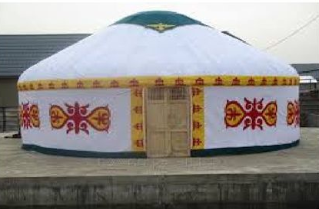
New vocabulary
Nomad steppe
beetle grasshopper
dragonfly petal
warrior politician
victory peacemaker
battles

Slide 3
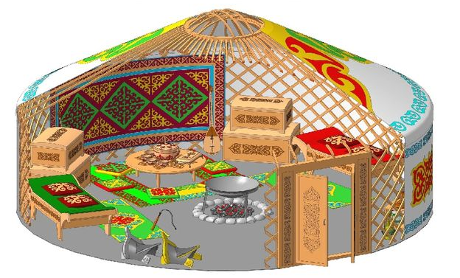
Reading the text
“Home where the yurt is”
Answer the question “What do you know about yurts?”
Read the title and the first paragraph. What do you think the text will be about?

Slide 4
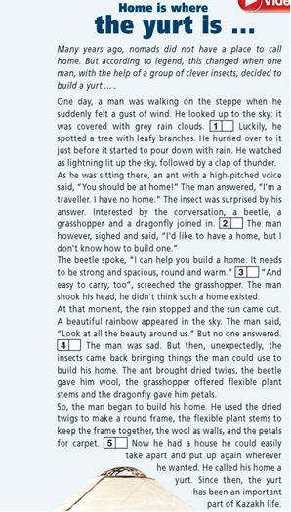

Slide 5
Read the text and fill in the gaps (1-5) with a correct sentence (A-F). One sentence is extra
A. “And beautiful with light, day and night." added the dragonfly.
В .He left a hole at the top for light.
C. They each talked about how great their homes were.
D. The insects were gone E He knew a huge storm was approaching and he needed to find shelter immediately.
F. Putting up the yurt was really difficult for the man.

Slide 6
Fill in: clap, dried, find, flexible, gust, high-pitched, leafy, pour. Use the phrases to make sentences based on the text.
1………. of wind
2……….down with rain
3………. branches
4……….of thunder
5……….voice
6……….shelter
7……….twigs
8……… plant stems

